Slide 1
Marie Kristel Bea G.Miñoza BSCS-1B
Documentation: Temperature Converter
1.Description of the study
A study on temperature converter would likely involve exploring different methods and algorithms for converting temperatures between Celsius, Fahrenheit.
2. Benefits to the User
Convenience: Users can quickly convert temperatures between different scales without the need for manual calculations or searching for conversion formulas.
Accuracy: Temperature converters ensure accurate conversions, eliminating the possibility of human error in calculations.
Flexibility: Users can convert temperatures between various scales such as Celsius, Fahrenheit, depending on their needs.
Time-saving: With a temperature converter, users can perform conversions in seconds, saving time compared to manual calculations.
Ease of Use: Most temperature converters are user-friendly and intuitive, requiring minimal effort to input values and obtain results.
Educational Tool: Temperature converters can serve as educational tools, helping users understand the relationships between different temperature scales and how to convert between them.
Wider Applicability: Temperature converters are useful in various fields such as science, engineering, cooking, and everyday life, making them valuable tools for a diverse range of users.

Slide 2
3.Objective
The temperature converter is to provide a tool for converting temperatures between different units of measurement, such as Celsius, Fahrenheit. This allows users to easily translate temperatures from one scale to another, facilitating communication and comprehension across different systems of measurement.
4.Purpose of the Code
The purpose of the temperature converter is to create code typically serves the purpose of converting temperatures from one scale to another it might convert temperatures from Celsius to Fahrenheit, or vice versa, or between other temperature scales like.
5.Significance of the Code/Features of the Code
Conversion Accuracy: The code should accurately convert temperatures between different scales, ensuring precision in scientific, engineering, or everyday applications. This accuracy ensures that users can rely on the converted values for their purposes, whether it's for cooking, weather forecasting, or laboratory experiments.
Multiple Scale Support: Supporting conversion between various temperature scales such as Celsius, Fahrenheit, Kelvin, and possibly others ensures versatility. Different applications may require temperatures to be represented in different scales, and the code's ability to handle multiple scales enhances its usefulness across diverse scenarios.
User-Friendly Interface: A user-friendly interface with clear instructions and intuitive input/output mechanisms enhances usability. Users should find it easy to input temperatures in one scale and obtain the converted values in another scale without needing to understand the underlying conversion formulas.
Error Handling: Robust error handling capabilities are crucial for ensuring the code behaves predictably even when encountering invalid inputs or exceptional conditions. Proper error handling prevents crashes and provides informative feedback to users, helping them correct their input mistakes.
Efficiency: Efficient implementation ensures that the code performs conversions quickly, making it suitable for real-time applications or scenarios where large datasets need to be processed. Efficient algorithms and coding practices optimize resource usage and minimize computational overhead.
Modularity and Reusability: Organizing the code into modular components allows for easy maintenance, scalability, and reusability. Developers can leverage individual functions or modules for temperature conversion in different projects or contexts, enhancing productivity and code reuse.
Documentation and Comments: Clear documentation and comments within the code improve readability and maintainability. Developers can understand the code's functionality, purpose, and usage quickly, facilitating collaboration and future updates.
Testing and Validation: Thorough testing and validation procedures ensure that the code behaves as expected under various conditions. Unit tests, integration tests, and validation against known temperature values help verify the accuracy and reliability of the conversion algorithms.

Slide 3
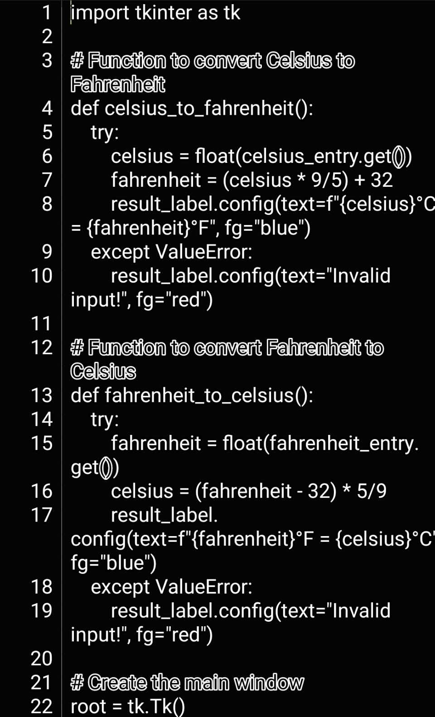
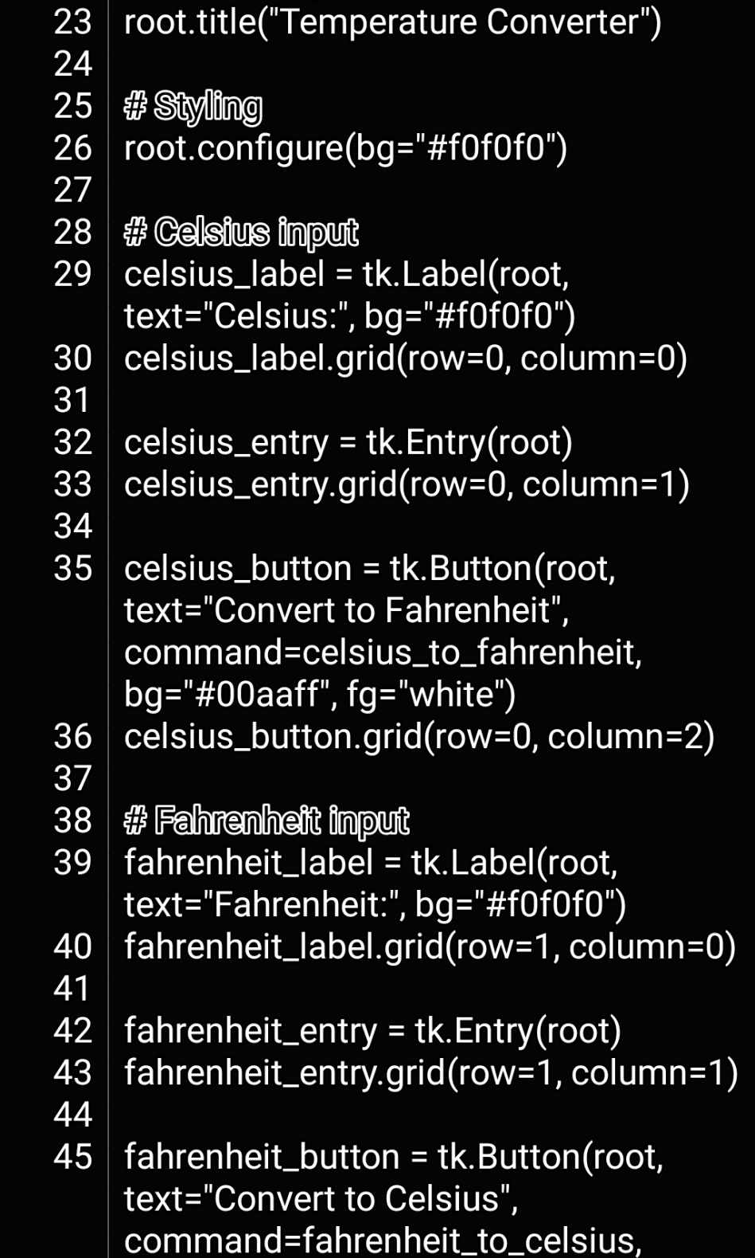
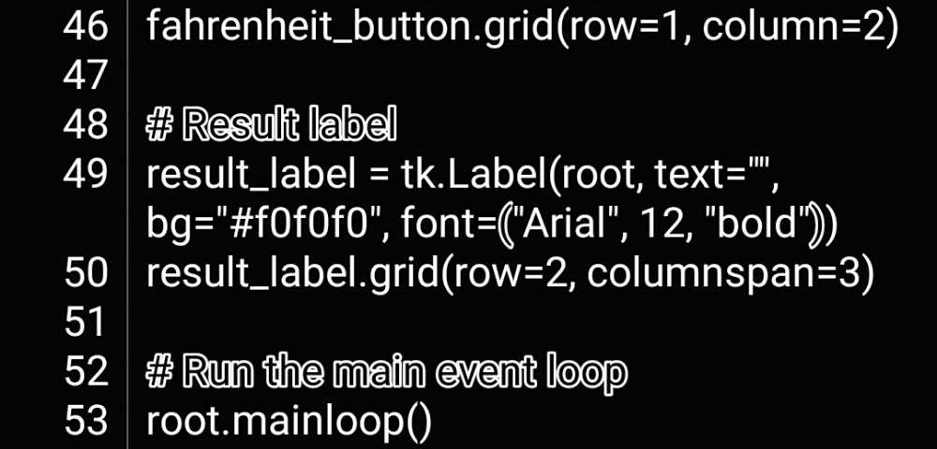
6.Code

Slide 4
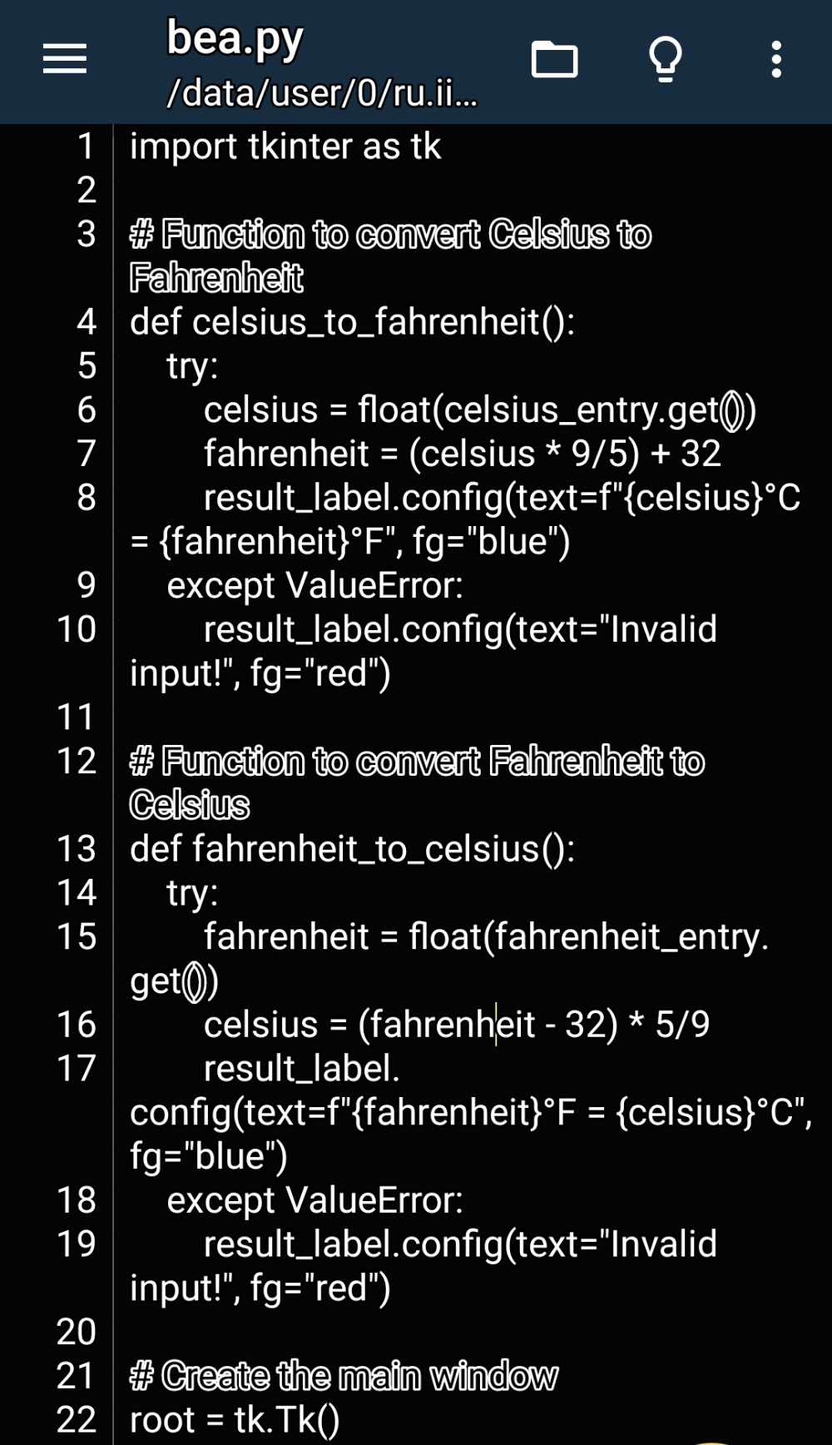
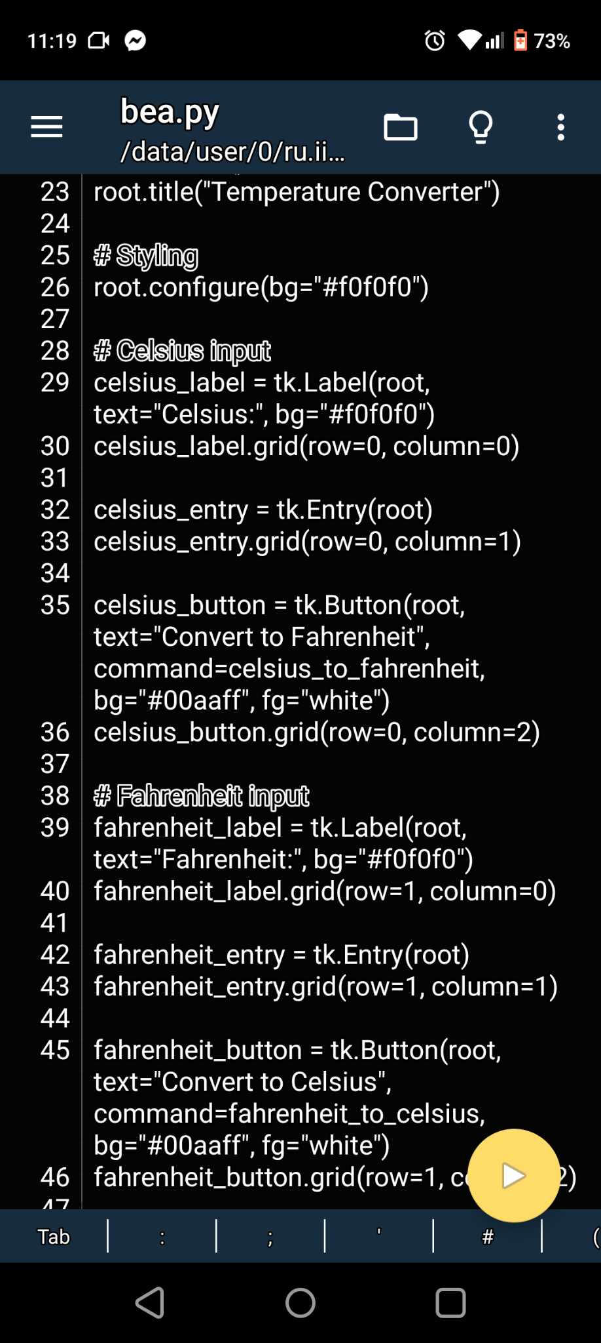
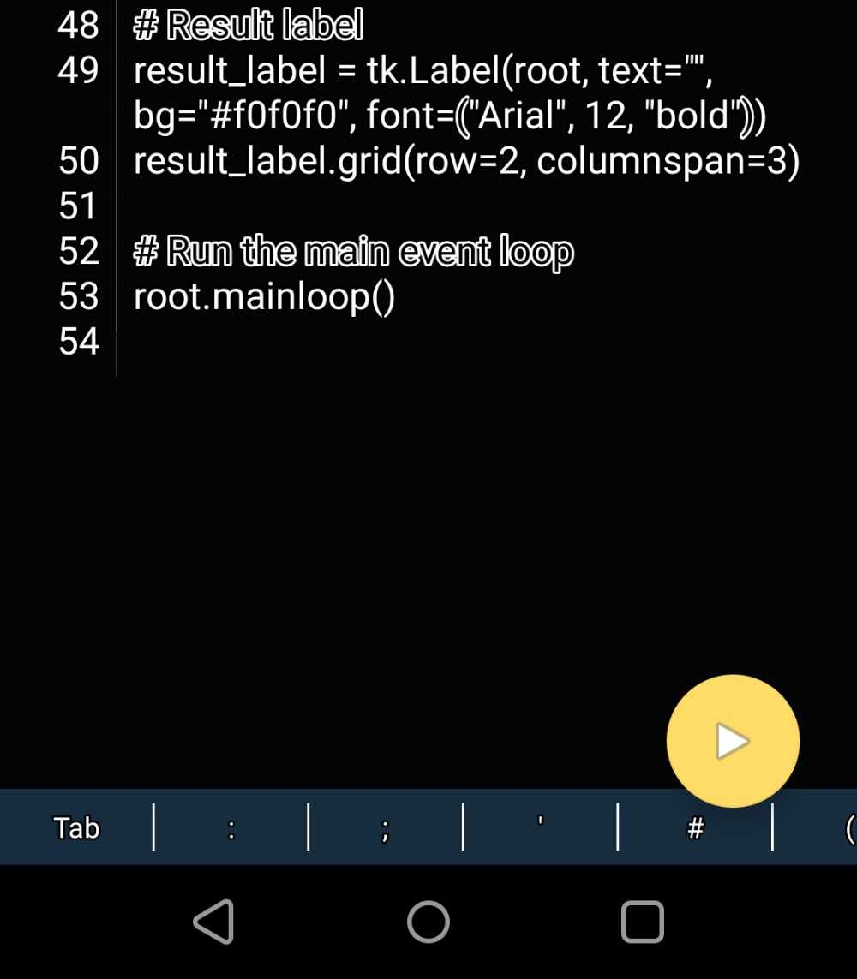
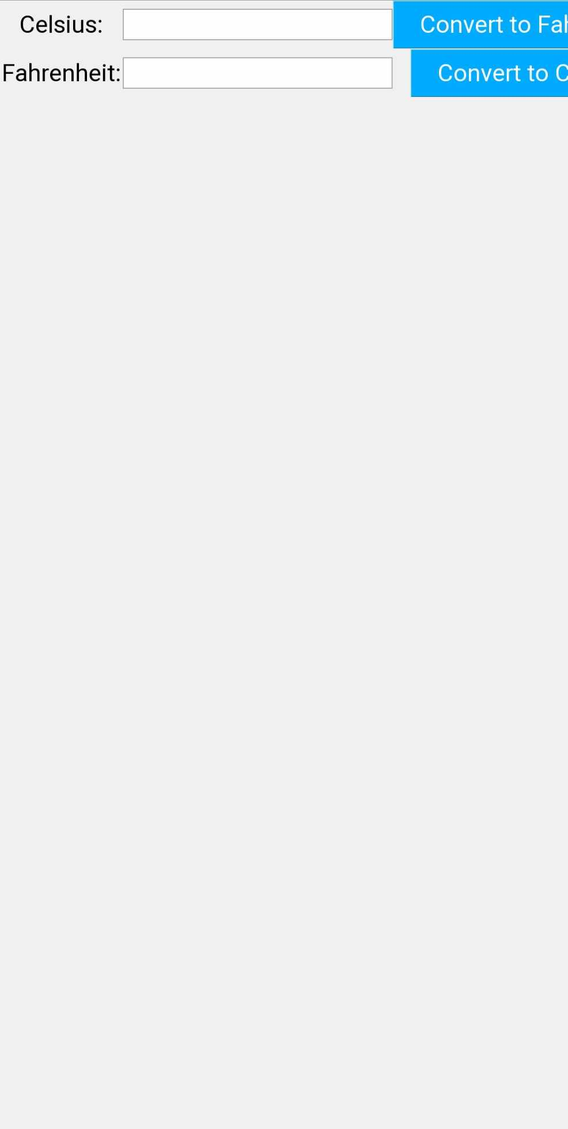
7.Screenshot

Slide 5

Contact number : 099522723739
8.Bio data
Personal Information
Name : Marie Kristel Bea G. Miñoza
Email address : mariekristelbea@gmail.com
Date of Birth : March 02,2005
Place of Birth: Surigao City
Address: P-9 Navalca, Brgy San Juan, Surigao City
Age: 19
Nationality: Filipino
Religion: Catholic
Civil Status: Single
Father’s Name: Niel Y. Miñoza
Mother’s Name: Zenia G. Miñoza

